Slide 1




Green Finance Education with Open Textbook, Open Course Delivery and AI: A VinUniversity Initiative
Presented by:
Dr Le Duy Anh, VinUniversity
Mr. Tony Tin, VinUniversity
Emerging Trends in Research & Scholarly Publishing
A Webinar Series by NTU Library
May 16th, 2024
PPT Download

Slide 2

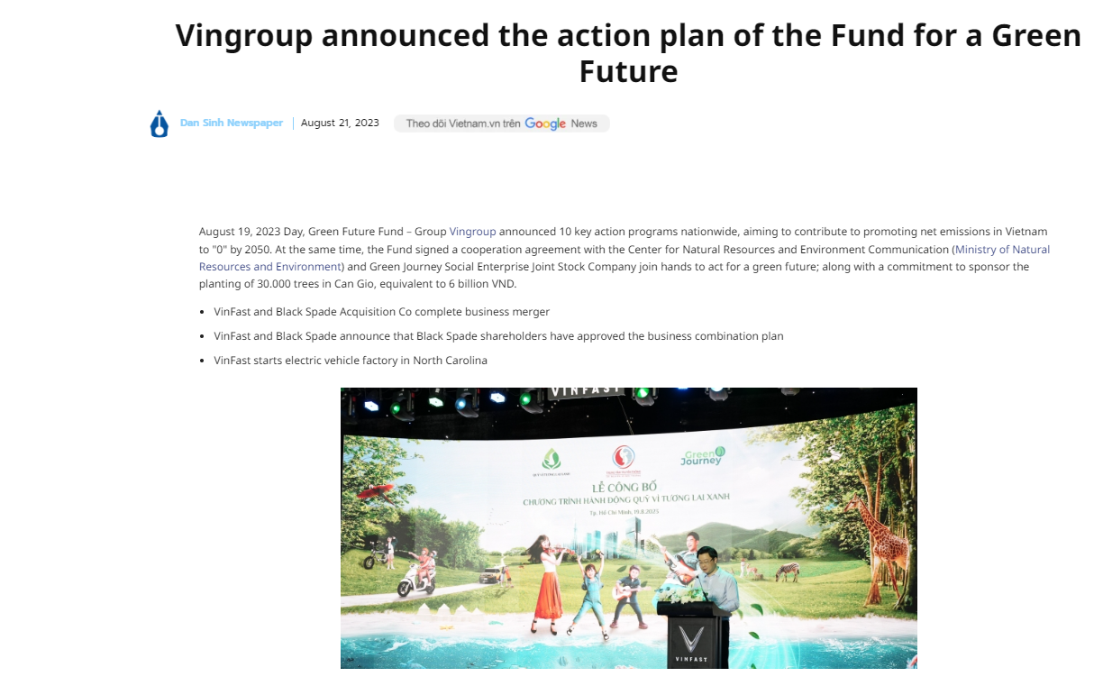
Green Finance: A Strategic Educational Initiative
What is Green Finance?
Funding sustainable businesses for a healthier planet.
Why It Matters
Crucial for Vietnam’s sustainable growth.
Supports VinUni and VinGroup sustainability missions.
Educational Approach
Open textbooks & courses for easy access to academic and non-academic audience
AI tools to personalize and enhance learning.
Real-World Impact
Prepares students to lead green initiatives effectively Knowledge-Attitude- Practice pathway (Green loan Initiative and consumer behavior studies)

Slide 3

Challenges and Future of Green Finance in Education:
The Role of Technologies
Challenges:
Low awareness and expertise.
Gaps in green finance curriculum.
Limited real-world learning.
Tech Solutions:
OERs – Free, accessible green finance content.
AI tools – Personalized, interactive learning.
Open courses – Scalable education for all.
Future Focus:
Empower students with practical green finance skills.
Support Vietnam’s sustainable development goals via education and training
Carbon Market Education for SMEs using the same technology funded by British Council (Alumni UK Climate Action Grant Winners)

Slide 4




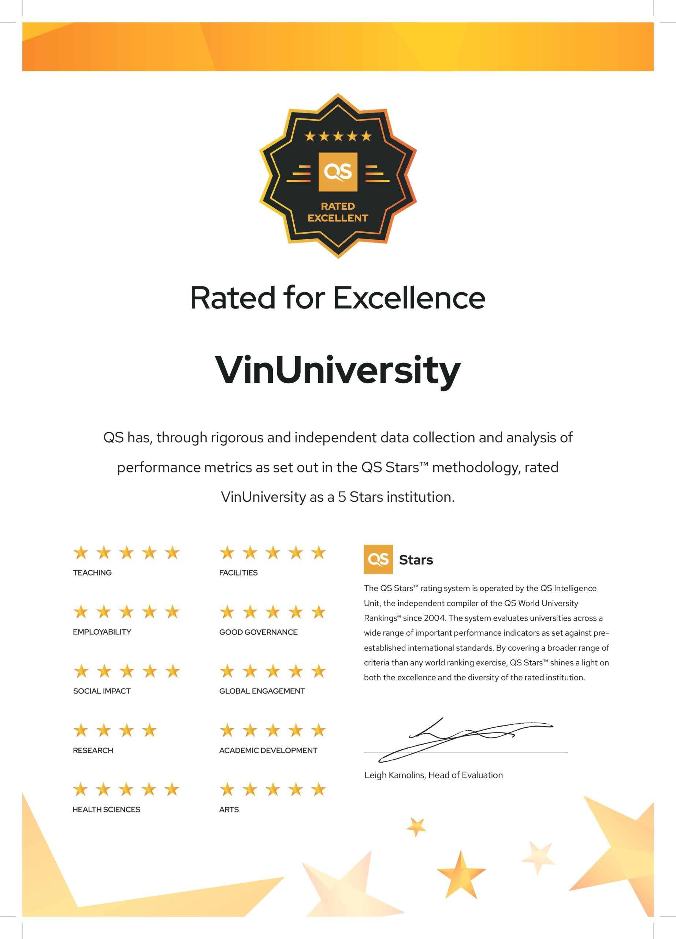
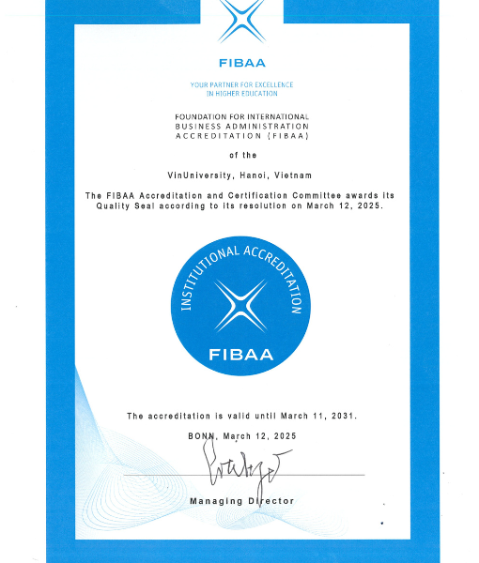
ABOUT VINUNI
VinUniversity is a private, not-for-profit university established by Vingroup – the largest private conglomerate in Vietnam. VinUni aspires to become a university of excellence with a mission to develop talents for the future.
4 Colleges
  College of Arts and Sciences
  College of Business and Management
  College of Engineering and Computer Science
  College of Health Sciences.
Every aspect of the University is developed to meet the highest standards set by the world’s leading accrediting and ranking organizations, such as FIBAA, Quacquarelli Symonds (QS), and Times Higher Education (THE).
1300+ students, 255 faculty/staff
Strategic collaborations
https://vinuni.edu.vn

Slide 5

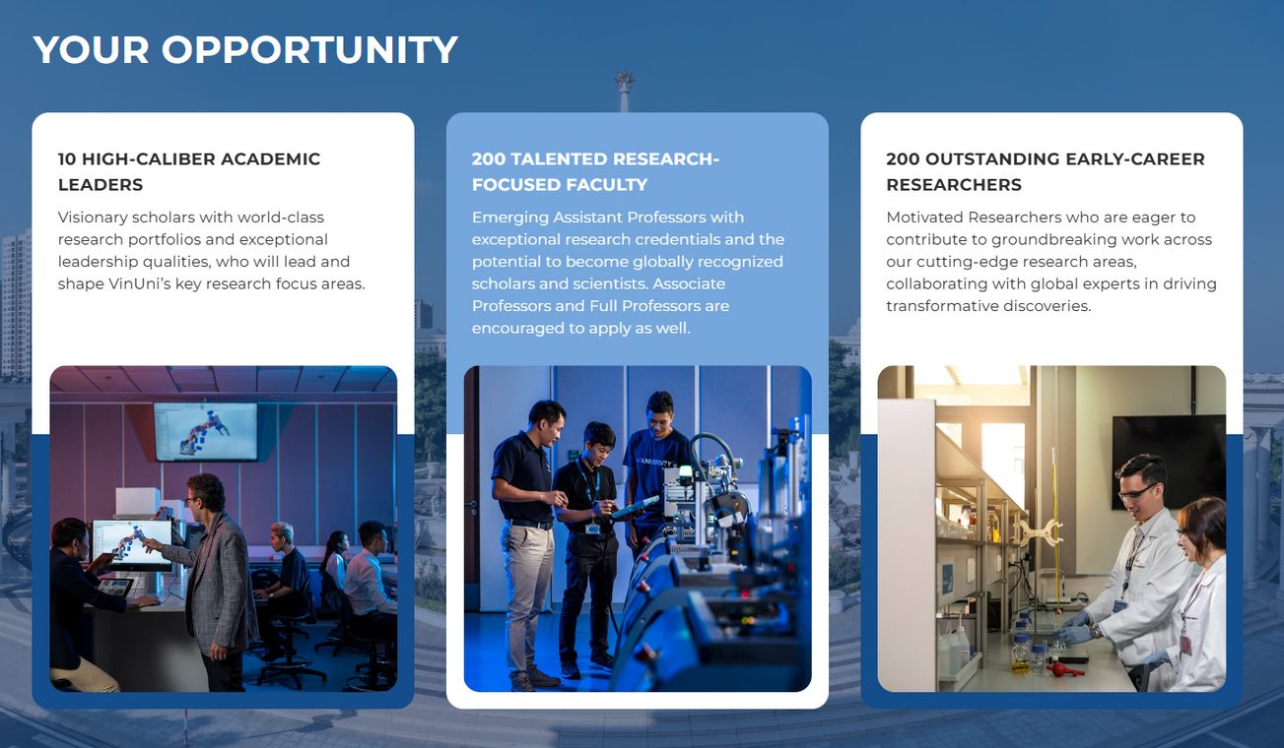
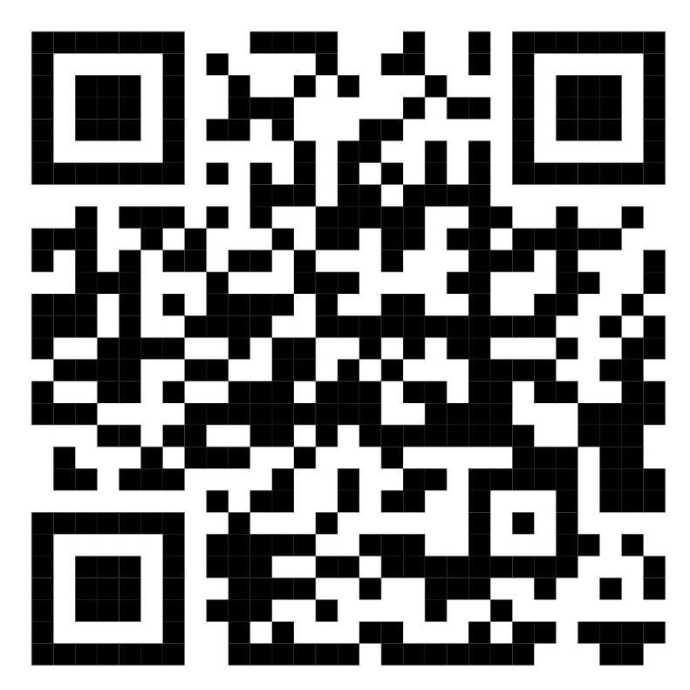
One of the World’s top universities by 2030.
WE ARE
HIRING
Find out more!
https://legacyofexcellence.vinuni.edu.vn/

Slide 6
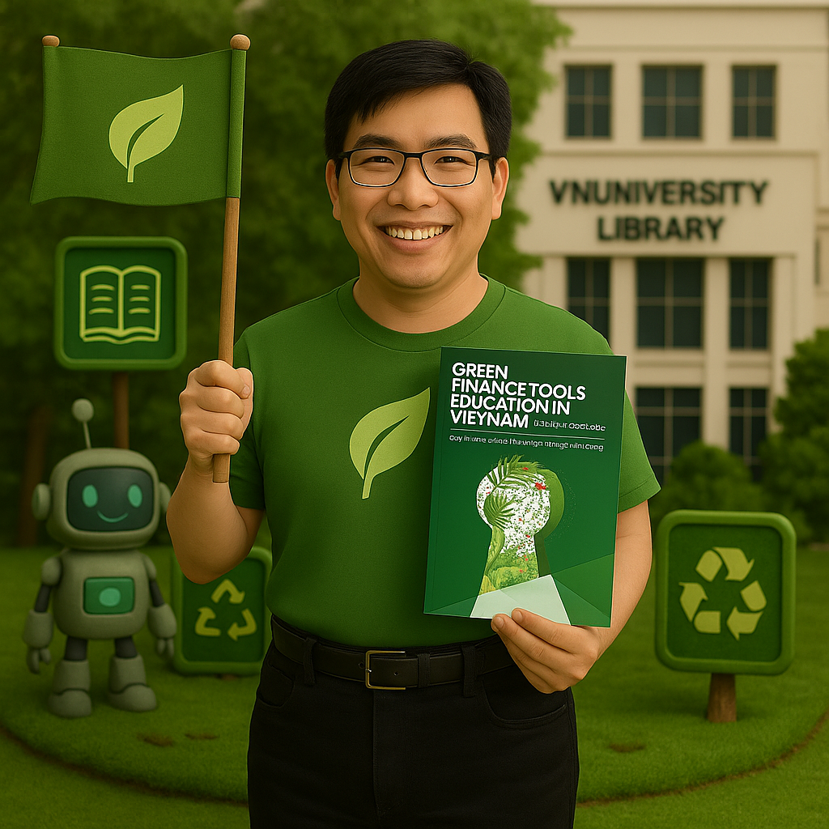

Traditional Textbook VS: AI eBook
Feature | Traditional Textbooks | AI-Enhanced eBooks
Format | Print or static digital PDF | Dynamic, Interactive, multimedia-rich digital format
Content Update | Infrequent, requires reprinting | Real-time or periodic updates powered by AI
Learning Support | Limited to text and images | AI tutor, chat assistant, flashcards, quizzes
Engagement | Passive reading | Interactive elements (e.g., gamification, AR/VR, mind maps)
Personalization | One-size-fits-all | Adaptive learning paths (modularized) based on student progress
Accessibility | May be costly or unavailable digitally | Affordable, cloud-based, and accessible on multiple devices
Production Model | Publisher-driven, high cost | Faculty or institution-led, low-cost self-publishing
Integration with Learning Tools | Not easily integrated | Seamless integration with LMS, Gen AI tools, and assessments
Environmental Impact | Resource consumption, physical shipping | Digital distribution, reduced carbon footprint, Net Zero.

Slide 7

Benefits of Open & AI-Powered Textbooks
Affordable & Accessible
Save costs by replacing expensive textbooks with free digital ones. Widely accessible anytime, anywhere (e.g. eCampus Ontario Open Library, ACU OER project )
AI-Ready & Copyright-Free
Open textbooks work well with AI tools and avoid copyright issues—giving faculty full freedom to innovate.
Wider Reach & Reputation
Promotes educational equity and boosts the university’s global visibility.
Empowers Students
Gives learners control and flexibility in how they study.
Fuels Faculty Innovation
Supports self-publishing and rewards educators for content creation.
MOET-Backed
Aligns with the Ministry of Education’s push for digital and open learning

Slide 8
Why Open Textbooks and Courses Matter (Cont.)
Technology Integration: Platforms like Pressbook, Flipbook, Text to speech Read aloud text, for e-books, Doctranslate.io for Bi-lingual AI translation and Everlearn for AI-generated courses, offering innovative, interactive learning experiences.
Expansion Potential: Expanding the open textbook/course model to other Vietnamese universities can generate revenue through collaborative partnership.

Slide 9

Leveraging AI for Open Course Creation
Interactive Content: AI supports chat, creates dynamic learning materials like powerpoint, quizzes, flashcards, and mind maps (Mindpal).
Podcast support: AI generated by AskYourPdf.
Scalable Learning: AI-generated courses provide flexibility and scalability for green finance education.
Open Course Platform: Incorporating e-learning analytics, e-certification, and course/book sales drives deeper engagement and revenue.
Notes:
Google Notebook LLM.

Slide 10
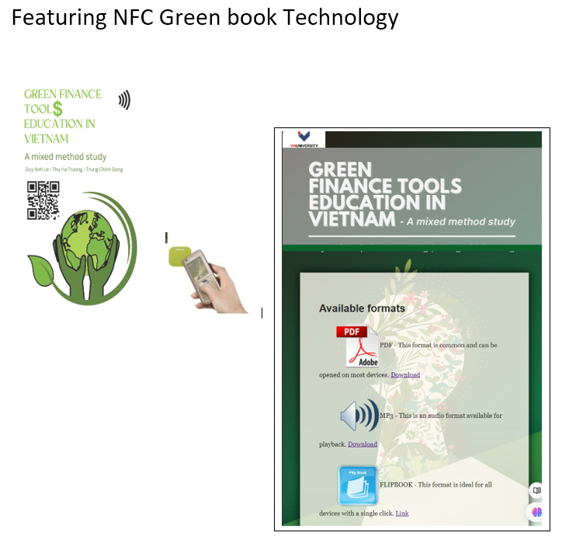
Revolutionizing Digital Access With NFC
Game change for learners!
Single-tap access to digital content in multiple formats like PDF, audio, and flipbook.
Benefits Include:
Effortless User Experience: Just a tap with any NFC-enabled device offers immediate access, eliminating the need for QR codes or complex downloads.
Eco-Friendly & Cost-Effective: Each NFC card costs less than $0.50, supporting sustainable, accessible green finance education.
On-the-Go Learning: Portable, allowing users to access and engage with content anytime, anywhere.
Future Enhancements:
Future NFC cards may include AR,AR1 allowing users to experience immersive content, like author summaries. (Model: VinUni history book)

Slide 11
Challenges
• Adoption Resistance:
Traditional mindset among educators and institutions.
• Quality Assurance:
Ensuring content accuracy and academic rigor
• Funding Needs:
Sustaining the initiative amid budget constraints.
• Infrastructure Gaps:
Limited access to digital devices in rural areas.

Slide 12
Future Goals
Expand the repository of open textbooks to cover diverse disciplines
Promote collaborations with other universities in Vietnam and Asia.
Encourage adoption through faculty workshops and incentives.
Advance the use of AR and AI to create immersive learning experiences.

Slide 13
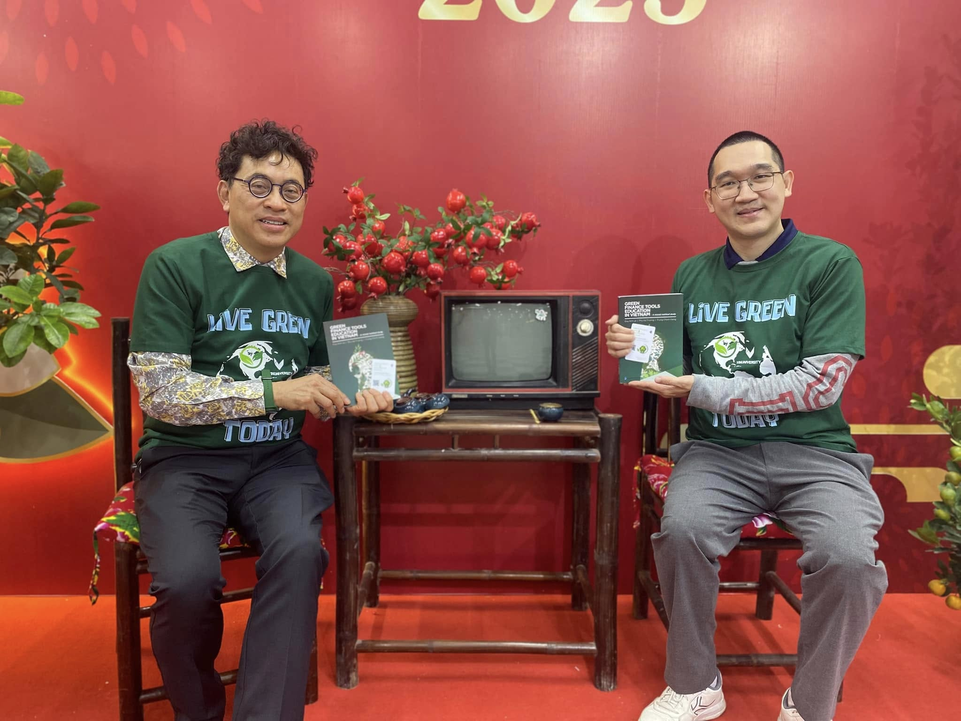
Conclusion
Pioneering
Pioneering Digital Education: Stay at forefront of democratizing access to education while generating new revenue streams.
Shaping
Shaping Vietnam’s Future: Bridge academic theory with real-world sustainability practices, advancing Vietnam’s green economy.
Position
Leadership in Green Finance: Position VinUni and VinGroup as leaders in Vietnam’s green transformation.

Slide 14
Reference
ASEAN Cyber University. (n.d.). ACU-OER Project. https://www.aseanoer.net/
AskYourPDF. (n.d.). AskYourPDF. https://askyourpdf.com
DocTranslate.io. (n.d.). DocTranslate.io. https://www.doctranslate.io/
eCampusOntario. (n.d.). Open Library. https://openlibrary.ecampusontario.ca/
EverLearns. (n.d.). EverLearns. https://everlearns.com/
FlipBuilder. (n.d.). Flip PDF. https://www.flipbuilder.com/flip-pdf/
Le, D. A., & Tin, T. (2025). Revolutionizing green finance education with AI: A VinUniversity initiative. Proceedings of the Open Innovation Conference 2025.
Le, D. A., Truong, T. H., Dang, T. C., & Tran, Q. T. (2024). Green finance tools education in Vietnam: A mixed method study. VinUniversity Library. https://pressbooks.pub/greenfinancetoolseducationinvietnam
MindPal. (n.d.). MindPal. https://mindpal.space/
NaturalReader. (n.d.). NaturalReader. https://www.naturalreaders.com
Pressbooks. (n.d.). Pressbooks. https://pressbooks.com
Thinkeric. (n.d.). Thinkeric. https://thinkeric.com
VinUniversity. (2024, March 15). Revolutionizing green finance education with AI: A VinUniversity initiative [Video]. YouTube. https://www.youtube.com/watch?v=GfuCJPFcHdY
VinUniversity Library. (n.d.). E-Bookstore. https://library.vinuni.edu.vn/services/e-bookstore/

Slide 15

Contact Us
Contact Information
Professor Le Duy Anh, anh.ld@vinuni.edu.vn
Mr. Tony Tin, tony.t@vinuni.edu.vn

